Slide 1
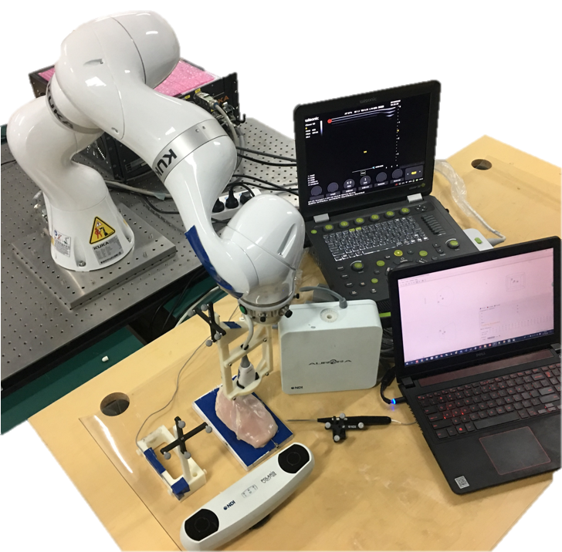
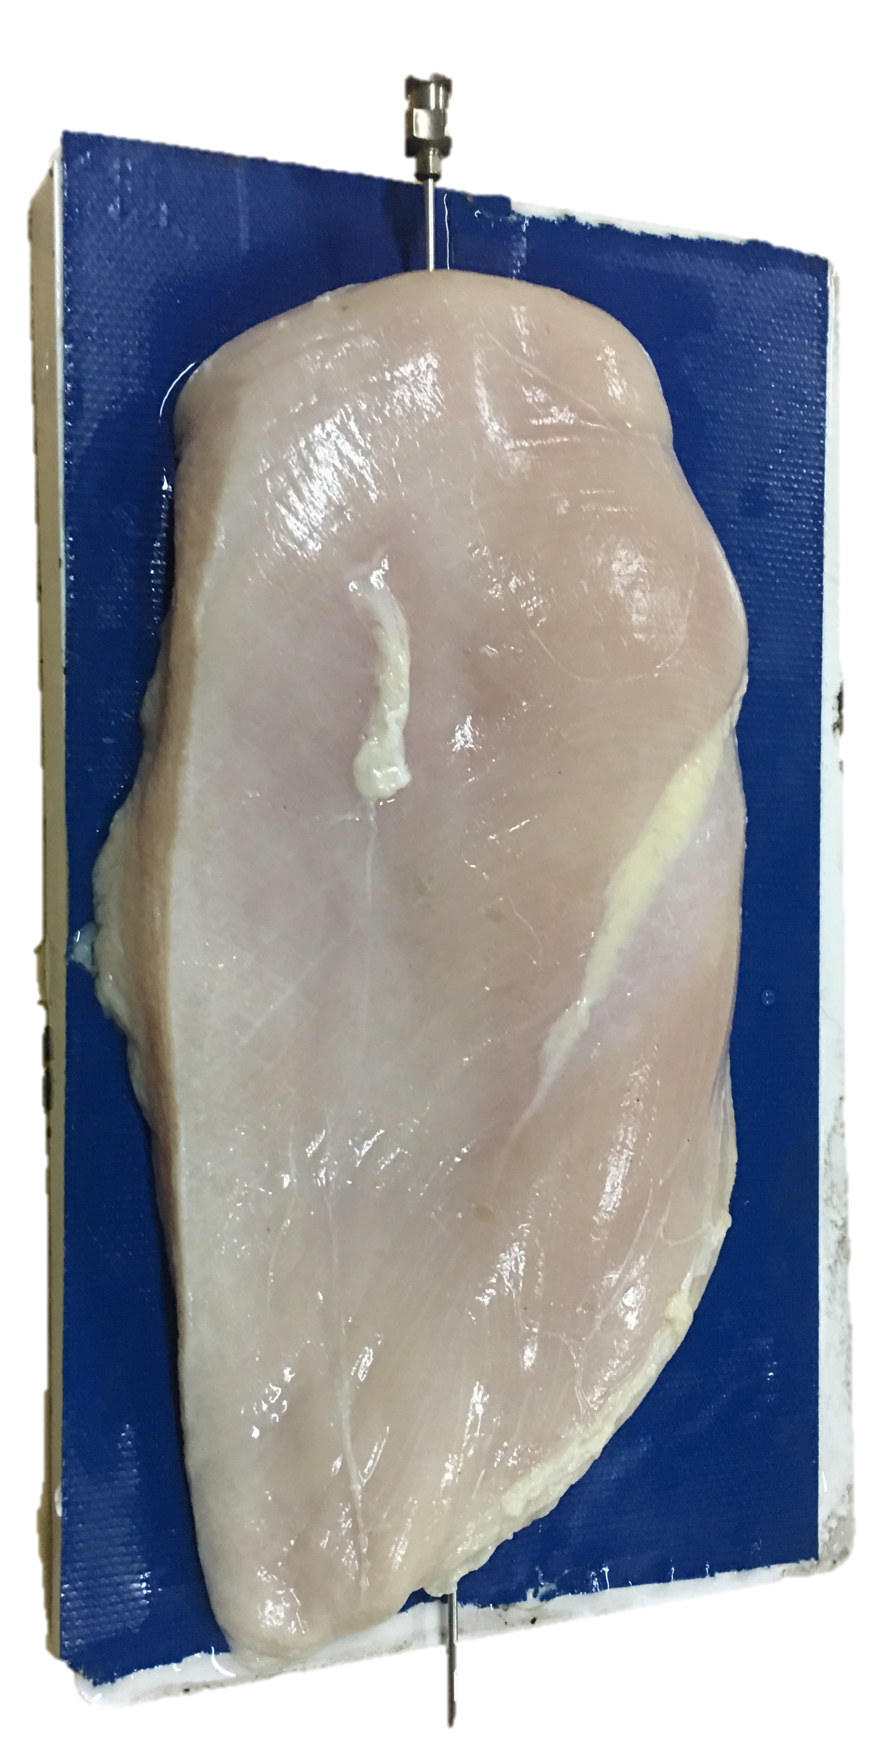
Robot Arm
Ultrasound Scanner
Needle
Electromagnetic Tracker
Chicken breast
US Probe
Reference
Computer
Needle Tip
Optical Tracker

